Slide 1
Natural Language Processing DSECL ZG565
Prof.Vijayalakshmi
BITS-Pilani

Slide 2
Session 6 -Probabilistic Context Free Grammar
Date – 4th Oct2020
Time – 9 am to 11am
These slides are prepared by the instructor, with grateful acknowledgement of Prof. Jurafsky and Prof. Martin and many others who made their course materials freely available online.

Slide 3
Session Content
(Ref: Chapter 14 Jurafsky and Martin)
CKY Parsing
Probabilistic Context-Free Grammars
PCFG for disambiguation
Probabilistic CKY Parsing of PCFGs
Ways to Learn PCFG Rule Probabilities
Probabilistic Lexicalized CFGs
Evaluating Parsers
Problems with PCFGs

Slide 4
Parsing algorithm
Top-down vs. bottom-up:
Top-down: (goal-driven): from the start symbol down.
Bottom-up: (data-driven): from the symbols up.
Naive vs. dynamic programming:
Naive: enumerate everything.
Backtracking: try something, discard partial solutions.
Dynamic programming: save partial solutions in a table.
Examples:
CKY: bottom-up dynamic programming.
Earley parsing: top-down dynamic programming.
Chart parsing –bottom up chart parsing
4

Slide 5
Issues with top down and Bottom up parsing
construction on other branch
Top down and bottom –up parsing both lead to repeated substructures
Globally bad parses can construct good subtrees
but overall parse will fail
Require tatic backtracking strategy can avoid
Efficient parsing techniques require storage of shared substructure
Typically with dynamic programming
Several implementations
CKY algorithm
Early algorithm
Chart parsing algorithm
5

Slide 6
CKY parsing
Classic, bottom-up dynamic programming algorithm (Cocke-Kasami-Younger).
Requires input grammar based on Chomsky Normal Form
A CNF grammar is a Context-Free Grammar in which:
Every rule LHS is a non-terminal
Every rule RHS consists of either a single terminal or two non-terminals.
Examples:
A → BC
NP → N PP
A → a
Noun → man
But not:
NP → the N
S →VP
6

Slide 7
Chomsky Normal Form
Any CFG can be re-written in CNF, without any loss of expressiveness.
That is, for any CFG, there is a corresponding CNF grammar which accepts exactly the same set of strings as the original CFG.
7

Slide 8
Converting a CFG to CNF
To convert a CFG to CNF, we need to deal with three issues:
Rules that mix terminals and non-terminals on the RHS
E.g. NP → the Nominal
Rules with a single non-terminal on the RHS (called unit productions)
E.g. NP → Nominal
Rules which have more than two items on the RHS
E.g. NP → Det Noun PP
8

Slide 9
Converting a CFG to CNF
Rules that mix terminals and non-terminals on the RHS
E.g. NP → the Nominal
Solution:
Introduce a dummy non-terminal to cover the original terminal
E.g. Det → the
Re-write the original rule:
NP → Det Nominal
Det → the
9

Slide 10
Converting a CFG to CNF
Rules with a single non-terminal on the RHS (called unit productions)
E.g. NP → Nominal
Solution:
Find all rules that have the form Nominal → ...
Nominal → Noun PP
Nominal → Det Noun
Re-write the above rule several times to eliminate the intermediate non-terminal:
NP → Noun PP
NP → Det Noun
Note that this makes our grammar “flatter”
10

Slide 11
Converting a CFG to CNF
Rules which have more than two items on the RHS
E.g. NP → Det Noun PP
Solution:
Introduce new non-terminals to spread the sequence on the RHS over more than 1 rule.
Nominal → Noun PP
NP → Det Nominal
11

Slide 12
CNF Grammar
If we parse a sentence with a CNF grammar, we know that:
Every phrase-level non-terminal (above the part of speech level) will have exactly 2 daughters.
NP → Det N
Every part-of-speech level non-terminal will have exactly 1 daughter, and that daughter is a terminal:
N → lady
12

Slide 13
Recognising strings with CKY
Example input: The flight includes a meal.
The CKY algorithm proceeds by:
Splitting the input into words and indexing each position.
(0) the (1) flight (2) includes (3) a (4) meal (5)
Setting up a table. For a sentence of length n, we need (n+1) rows and (n+1) columns.
Traversing the input sentence left-to-right
Use the table to store constituents and their span.
13

Slide 14
CKY example
S → NP VP
NP → Det N
VP → V NP
V → includes
Det → the
Det → a
N → meal
N → flight

Slide 15
CKY example
Rule: Det → the
[0,1] for “the”
 | 1 | 2 | 3 | 4 | 5
0 | Det |  |  |  | S
1
2
3
4
the
flight
includes
a
meal

Slide 16
CKY example
Rule1: Det → the
Rule 2: N → flight
[0,1] for “the”
[1,2] for “flight”
 | 1 | 2 | 3 | 4 | 5
0 | Det |  |  |  | S
1 |  | N
2
3
4
the
flight
includes
a
meal

Slide 17
CKY example
[0,2] for “the flight”
Rule1: Det → the
Rule 2: N → flight
Rule 3: NP → Det N
[0,1] for “the”
[1,2] for “flight”
 | 1 | 2 | 3 | 4 | 5
0 | Det | NP |  |  | S
1 |  | N
2
3
4
the
flight
includes
a
meal

Slide 18
CKY: lexical step (j = 1)
 | 1 | 2 | 3 | 4 | 5
0 | Det
1
2
3
4
5
Lexical lookup
Matches Det → the
The flight includes a meal.

Slide 19
CKY: lexical step (j = 2)
 | 1 | 2 | 3 | 4 | 5
0 | Det
1 |  | N
2
3
4
5
Lexical lookup
Matches N → flight
The flight includes a meal.

Slide 20
CKY: syntactic step (j = 2)
 | 1 | 2 | 3 | 4 | 5
0 | Det | NP
1 |  | N
2
3
4
5
Syntactic lookup:
look backwards and see if there is any rule that will cover what we’ve done so far.
The flight includes a meal.

Slide 21
CKY: lexical step (j = 3)
 | 1 | 2 | 3 | 4 | 5
0 | Det | NP
1 |  | N
2 |  |  | V
3
4
5
Lexical lookup
Matches V → includes
The flight includes a meal.

Slide 22
CKY: lexical step (j = 3)
 | 1 | 2 | 3 | 4 | 5
0 | Det | NP
1 |  | N
2 |  |  | V
3
4
5
Syntactic lookup
There are no rules in our grammar that will cover Det, NP, V
The flight includes a meal.

Slide 23
CKY: lexical step (j = 4)
 | 1 | 2 | 3 | 4 | 5
0 | Det | NP
1 |  | N
2 |  |  | V
3 |  |  |  | Det
4
5
Lexical lookup
Matches Det → a
The flight includes a meal.

Slide 24
CKY: lexical step (j = 5)
 | 1 | 2 | 3 | 4 | 5
0 | Det | NP
1 |  | N
2 |  |  | V
3 |  |  |  | Det
4 |  |  |  |  | N
Lexical lookup
Matches N → meal
The flight includes a meal.

Slide 25
CKY: syntactic step (j = 5)
 | 1 | 2 | 3 | 4 | 5
0 | Det | NP
1 |  | N
2 |  |  | V
3 |  |  |  | Det | NP
4 |  |  |  |  | N
Syntactic lookup
We find that we have NP → Det N
The flight includes a meal.

Slide 26
CKY: syntactic step (j = 5)
 | 1 | 2 | 3 | 4 | 5
0 | Det | NP
1 |  | N
2 |  |  | V |  | VP
3 |  |  |  | Det | NP
4 |  |  |  |  | N
Syntactic lookup
We find that we have VP → V NP
The flight includes a meal.

Slide 27
CKY: syntactic step (j = 5)
 | 1 | 2 | 3 | 4 | 5
0 | Det | NP |  |  | S
1 |  | N
2 |  |  | V |  | VP
3 |  |  |  | Det | NP
4 |  |  |  |  | N
Syntactic lookup
We find that we have S → NP VP
The flight includes a meal.
27

Slide 28
From recognition to parsing
The procedure so far will recognise a string as a legal sentence in English.
But we’d like to get a parse tree back!
Solution:
We can work our way back through the table and collect all the partial solutions into one parse tree.
Cells will need to be augmented with “backpointers”, i.e. With a pointer to the cells that the current cell covers.
28

Slide 29
From recognition to parsing
 | 1 | 2 | 3 | 4 | 5
0 | Det | NP |  |  | S
1 |  | N
2 |  |  | V |  | VP
3 |  |  |  | Det | NP
4 |  |  |  |  | N

Slide 30
From recognition to parsing
 | 1 | 2 | 3 | 4 | 5
0 | Det | NP |  |  | S
1 |  | N
2 |  |  | V |  | VP
3 |  |  |  | Det | NP
4 |  |  |  |  | N
NB: This algorithm always fills the top “triangle” of the table!
30

Slide 31
What about ambiguity?
The algorithm does not assume that there is only one parse tree for a sentence.
(Our simple grammar did not admit of any ambiguity, but this isn’t realistic of course).
There is nothing to stop it returning several parse trees.
If there are multiple local solutions, then more than one non-terminal will be stored in a cell of the table.
31

Slide 32
Some funny examples
– Policeman to littleboy: “We are looking for a thief with a bicycle.” Little boy: “Wouldn’t you be better using your eyes.”
– Why is the teacher wearing sun-glasses. Because the class is so bright.
32

Slide 33
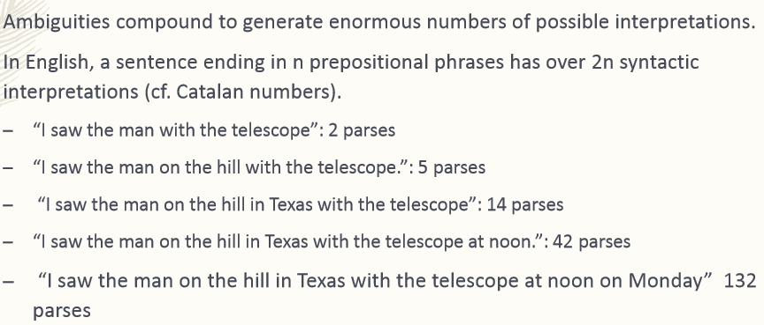
Ambiguity is Explosive
33

Slide 34
Motivation
Context-free grammars can be generalized to include probabilistic information by adding it to CFG rule
Probabilistic Context Free Grammars (PCFGs) are the simplest and most natural probabilistic model for tree structures and the algorithms for them are closely related to those for HMMs.
PCFG are also known as Stochastic Context-Free Grammar (SCFG)
34
Fall 2001
EE669: Natural Language Processing

Slide 35
CFG definition (reminder)
A CFG is a 4-tuple: (N,Σ,R,S):
N = a set of non-terminal symbols (e.g. NP, VP)
Σ = a set of terminals (e.g. words)
N and Σ are disjoint (no element of N is also an element of Σ)
R = a set of rules of the form A→β where:
A is a non-terminal (a member of N)
β is any string of terminals and non-terminals
S = a designated start symbol (usually, “sentence”)
35

Slide 36
Formal Definition of a PCFG
A PCFG consists of:
A set of terminals, {w^{k}}, k= 1,…,V
A set of nonterminals, N^{i}, i= 1,…, n
A designated start symbol N¹
A set of rules, {N^{i} → ξ^{j}}, (where ξ^{j} is a sequence of terminals and nonterminals)
A corresponding set of probabilities on rules such that: ∀i Σj P(N^{i} → ξ^{j}) = 1
36
Fall 2001
EE669: Natural Language Processing
36

Slide 37
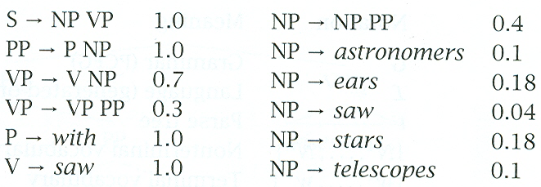
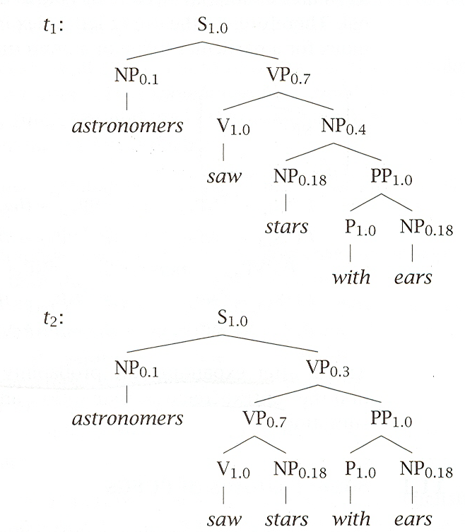
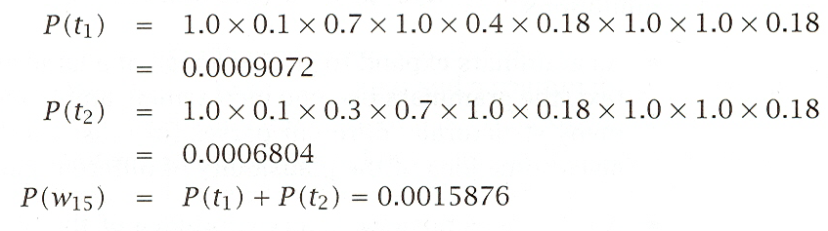
Example: Probability of a Derivation Tree
Fall 2001
EE669: Natural Language Processing
37

Slide 38
Probability of a Derivation Tree and a String
The probability of a derivation (i.e. parse) tree:
P(T) = Πi=1..k p(r(i))
where r(1), …, r(k) are the rules of the CFG used to generate the sentence w1m of which T is a parse.
The probability of a sentence (according to grammar G) is given by:
P(w1m) = Σt P(w1m,t) = Σ{t: yield(t)=w_{1m}} P(t)
where t is a parse tree of the sentence. Need dynamic programming to make this efficient!
38
Fall 2001
EE669: Natural Language Processing

Slide 39
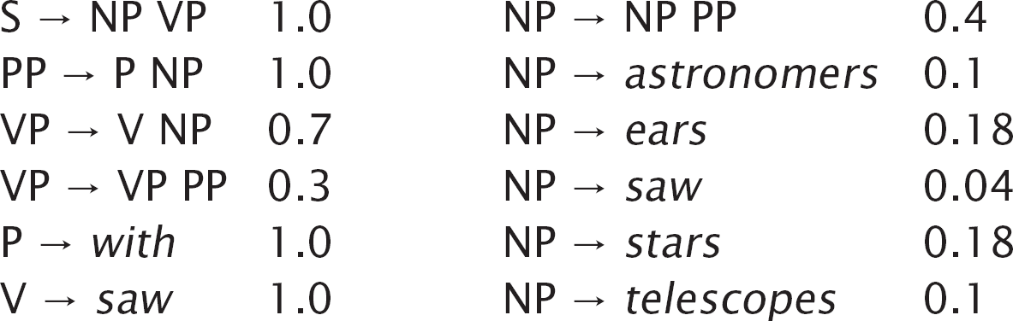
Example
Terminals
with, saw, astronomers, ears, stars, telescopes
S, PP, P, NP, VP, V
S
Nonterminals
Start symbol

Slide 40
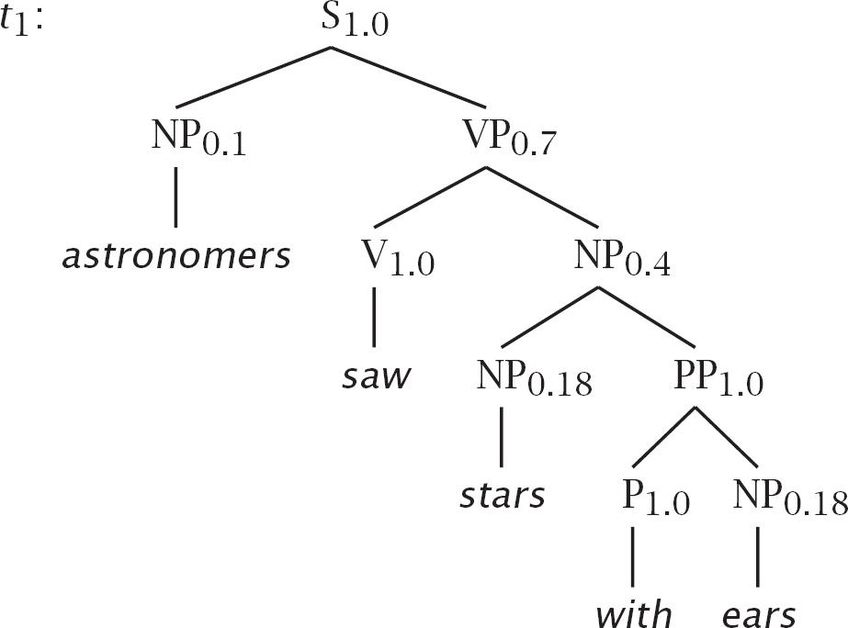
astronomers saw stars with ears

Slide 41
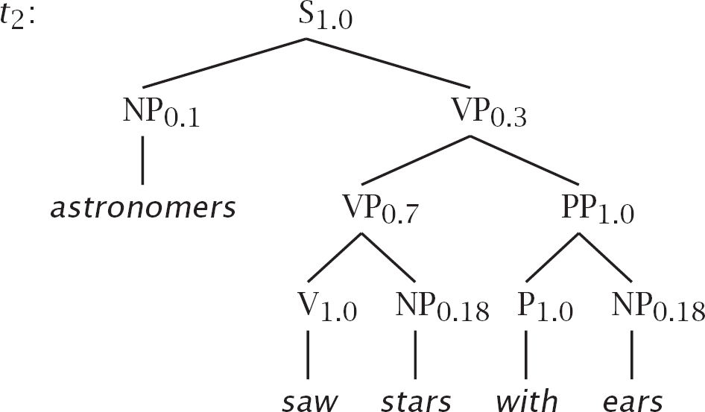
astronomers saw stars with ears

Slide 42


Probabilities
P (t₁)
= 1.0 × 0.1 × 0.7 × 1.0 × 0.4
×0.18 × 1.0 × 1.0 × 0.18
= 0.0009072
= 1.0 × 0.1 × 0.3 × 0.7 × 1.0
×0.18 × 1.0 × 1.0 × 0.18
= 0.0006804
= P (t₁)+ P (t₂) = 0.0015876
P (t₂)
P (w₁₅)

Slide 43
Example2
P(TL) = 1.5 x 10⁻⁶
P(TR) = 1.7 x 10⁻⁶
P(S) = 3.2 x 10⁻⁶
43

Slide 44
Some Features of PCFGs
A PCFG gives some idea of the plausibility of different parses; however, the probabilities are based on structural factors and not lexical ones.
PCFGs are good for grammar induction.
PCFGs are robust.
PCFGs give a probabilistic language model for English.
The predictive power of a PCFG tends to be greater than for an HMM.
PCFGs are not good models alone but they can be combined with a trigram model.
44
Fall 2001
EE669: Natural Language Processing
44

Slide 45
Properties of PCFGs
Assigns a probability to each left-most derivation, or parse-tree, allowed by the underlying CFG
Say we have a sentence s, set of derivations for that sentence is T (s). Then a PCFG assigns a probability p(t) to each member of T (s). i.e., we now have a ranking in order of probability.
The most likely parse tree for a sentence s is
arg max p(t)
t∈T (s)
45

Slide 46
Data for Parsing Experiments: Treebanks
Penn WSJ Treebank = 50,000 sentences with associated trees
Usual set-up: 40,000 training sentences, 2400 test sentences
An example tree:
TOP
S
NP
VP
NNP NNPS VBD
NP
PP
NP
PP
ADVP
IN
NP
CD NN IN
NP
RB
NP
PP
QP
PRP$
JJ NN CC
JJ NN NNS IN
NP
$ CD CD PUNC,
NP
SBAR
NNP PUNC, WHADVP
S
WRB
NP
VP
DT NN
VBZ
NP
QP
NNS PUNC.
RB CD
Canadian Utilities had 1988 revenue of C$ 1.16 billion ,
mainly from its
natural gas and electric utility businessesin Alberta , where
the company serves about 800,000 customers .
46

Slide 47
Example tree

Slide 48
Word/Tag Counts
Fall 2001
EE669: Natural Language Processing
48

Slide 49
Lexical Probability Estimates
The table below gives the lexical probabilities which
are needed for our example:
49
EE669: Natural Language Processing
49

Slide 50
The PCFG
Below is a probabilistic CFG (PCFG) with probabilities derived from analyzing a parsed version of Allen's corpus.
50
Fall 2001
EE669: Natural Language Processing

Slide 51
Parsing with a PCFG
Using the lexical probabilities, we can derive probabilities that the constituent NP generates a sequence like a flower. Two rules could generate the string of words:
51
Fall 2001
EE669: Natural Language Processing

Slide 52
Three Possible Trees for an S
52
Fall 2001
EE669: Natural Language Processing

Slide 53
Parsing with a PCFG
The probability of a sentence generating A flower wilted:
P(a flower wilted|S) = P(R1|S) × P(a flower|NP) × P(wilted|VP) + P(R1|S) × P(a|NP) × P(flower wilted|VP)
Using this approach, the probability that a given sentence will be generated by the grammar can be efficiently computed.
It only requires some way of recording the value of each constituent between each two possible positions. The requirement can be filled by a packed chart structure.
53
Fall 2001
EE669: Natural Language Processing

Slide 54
Uses of probabilities in parsing
Disambiguation: given n legal parses of a string, which is the most likely?
e.g. PP-attachment ambiguity can be resolved this way
Speed: we’ve defined parsing as a search problem
search through space of possible applicable derivations
search space can be pruned by focusing on the most likely sub-parses of a parse
Parser can be used as a model to determine the probability of a sentence, given a parse
typical use in speech recognition, where input utterance can be “heard” as several possible sentences
54

Slide 55
Using PCFG probabilities
PCFG assigns a probability to every parse-tree t of a string W
e.g. every possible parse (derivation) of a sentence recognised by the grammar
Notation:
G = a PCFG
s = a sentence
t = a particular tree under our grammar
t consists of several nodes n
each node is generated by applying some rule r
55

Slide 56
Probability of a tree vs. a sentence
We work out the probability of a parse tree t by multiplying the probability of every rule (node) that gives rise to t (i.e. the derivation of t).
Note that:
A tree can have multiple derivations
(different sequences of rule applications could give rise to the same tree)
But the probability of the tree remains the same
(it’s the same probabilities being multiplied)
We usually speak as if a tree has only one derivation, called the canonical derivation
56

Slide 57
Picking the best parse in a PCFG
A sentence will usually have several parses
we usually want them ranked, or only want the n best parses
we need to focus on P(t|s,G)
probability of a parse, given our sentence and our grammar
definition of the best parse for s:
The tree for which P(t|s,G) is highest
57

Slide 58
Probability of a sentence
Given a probabilistic context-free grammar G, we can the probability of a sentence (as opposed to a tree).
Observe that:
As far as our grammar is concerned, a sentence is only a sentence if it can be recognised by the grammar (it is “legal”)
There can be multiple parse trees for a sentence.
Many trees whose yield is the sentence
The probability of the sentence is the sum of all the probabilities of the various trees that yield the sentence.
58

Slide 59
Using CKY to parse with a PCFG
The basic CKY algorithm remains unchanged.
However, rather than only keeping partial solutions in our table cells (i.e. The rules that match some input), we also keep their probabilities.
59

Slide 60
Probabilistic CKY: example PCFG
S → NP VP [.80]
NP → Det N [.30]
VP → V NP [.20]
V → includes [.05]
Det → the [.4]
Det → a [.4]
N → meal [.01]
N → flight [.02]
60

Slide 61
Probabilistic CYK: initialisation
 | 1 | 2 | 3 | 4 | 5
0
1
2
3
4
5
The flight includes a meal.
S → NP VP [.80]
NP → Det N [.30]
VP → V NP [.20]
V → includes [.05]
Det → the [.4]
Det → a [.4]
N → meal [.01]
N → flight [.02]
61

Slide 62
Probabilistic CYK: lexical step
 | 1 | 2 | 3 | 4 | 5
0 | Det (.4)
1
2
3
4
5
S → NP VP [.80]
NP → Det N [.30]
VP → V NP [.20]
V → includes [.05]
Det → the [.4]
Det → a [.4]
N → meal [.01]
N → flight [.02]
The flight includes a meal.
62

Slide 63
Probabilistic CYK: lexical step
 | 1 | 2 | 3 | 4 | 5
0 | Det (.4)
1 |  | N .02
2
3
4
5
S → NP VP [.80]
NP → Det N [.30]
VP → V NP [.20]
V → includes [.05]
Det → the [.4]
Det → a [.4]
N → meal [.01]
N → flight [.02]
The flight includes a meal.
63

Slide 64
Probabilistic CYK: syntactic step
 | 1 | 2 | 3 | 4 | 5
0 | Det (.4) | NP .0024
1 |  | N .02
2
3
4
5
S → NP VP [.80]
NP → Det N [.30]
VP → V NP [.20]
V → includes [.05]
Det → the [.4]
Det → a [.4]
N → meal [.01]
N → flight [.02]
The flight includes a meal.
Note: probability of NP in [0,2]
P(Det → the) * P(N → flight) * P(NP → Det N)
64

Slide 65
Probabilistic CYK: lexical step
S → NP VP [.80]
NP → Det N [.30]
VP → V NP [.20]
V → includes [.05]
Det → the [.4]
Det → a [.4]
N → meal [.01]
N → flight [.02]
 | 1 | 2 | 3 | 4 | 5
0 | Det (.4) | NP .0024
1 |  | N .02
2 |  |  | V .05
3
4
5
The flight includes a meal.

Slide 66
Probabilistic CYK: lexical step
 | 1 | 2 | 3 | 4 | 5
0 | Det (.4) | NP .0024
1 |  | N .02
2 |  |  | V .05
3 |  |  |  | Det .4
4
5
S → NP VP [.80]
NP → Det N [.30]
VP → V NP [.20]
V → includes [.05]
Det → the [.4]
Det → a [.4]
N → meal [.01]
N → flight [.02]
The flight includes a meal.

Slide 67
Probabilistic CYK: syntactic step
S → NP VP [.80]
NP → Det N [.30]
VP → V NP [.20]
V → includes [.05]
Det → the [.4]
Det → a [.4]
N → meal [.01]
N → flight [.02]
 | 1 | 2 | 3 | 4 | 5
0 | Det (.4) | NP .0024
1 |  | N .02
2 |  |  | V .05
3 |  |  |  | Det .4
4 |  |  |  |  | N .01
The flight includes a meal.

Slide 68
Probabilistic CYK: syntactic step
S → NP VP [.80]
NP → Det N [.30]
VP → V NP [.20]
V → includes [.05]
Det → the [.4]
Det → a [.4]
N → meal [.01]
N → flight [.02]
 | 1 | 2 | 3 | 4 | 5
0 | Det (.4) | NP .0024
1 |  | N .02
2 |  |  | V .05
3 |  |  |  | Det .4 | NP .001
4 |  |  |  |  | N .01
The flight includes a meal.

Slide 69
Probabilistic CYK: syntactic step
S → NP VP [.80]
NP → Det N [.30]
VP → V NP [.20]
V → includes [.05]
Det → the [.4]
Det → a [.4]
N → meal [.01]
N → flight [.02]
 | 1 | 2 | 3 | 4 | 5
0 | Det (.4) | NP .0024
1 |  | N .02
2 |  |  | V .05 |  | VP .00001
3 |  |  |  | Det .4 | NP .001
4 |  |  |  |  | N .01
The flight includes a meal.

Slide 70
S → NP VP [.80]
NP → Det N [.30]
VP → V NP [.20]
V → includes [.05]
Det → the [.4]
Det → a [.4]
N → meal [.01]
N → flight [.02]
 | 1 | 2 | 3 | 4 | 5
0 | Det (.4) | NP .0024 |  |  | S .0000000192
1 |  | N .02
2 |  |  | V .05 |  | VP .00001
3 |  |  |  | Det .4 | NP .001
4 |  |  |  |  | N .01
The flight includes a meal.

Slide 71
Probabilistic CYK: summary
Cells in chart hold probabilities
Bottom-up procedure computes probability of a parse incrementally.
To obtain parse trees, we traverse the table “backwards” as before.
Cells need to be augmented with backpointers.
71

Slide 72
Problems with PCFGs
No Context
(immediate prior context, speaker, …)
No Lexicalization
“VP NP NP” more likely if verb is “hand” or “tell”
fail to capture lexical dependencies (n‐grams do)
72

Slide 73
Flaws I: Structural independence
Probability of a rule r expanding node n depends only on n.
Independent of other non-terminals
Example:
P(NP → Pro) is independent of where the NP is in the sentence
but we know that NP→Pro is much more likely in subject position
Francis et al (1999) using the Switchboard corpus:
91% of subjects are pronouns;
only 34% of objects are pronouns
73

Slide 74
Flaws II: lexical independence
vanilla PCFGs ignore lexical material
e.g. P(VP → V NP PP) independent of the head of NP or PP or lexical head V
Examples:
prepositional phrase attachment preferences depend on lexical items; cf:
dump [sacks into a bin]
dump [sacks] [into a bin] (preferred parse)
coordination ambiguity:
[dogs in houses] and [cats]
[dogs] [in houses and cats]
74

Slide 75
Lexicalised PCFGs
Attempt to weaken the lexical independence assumption.
Most common technique:
mark each phrasal head (N,V, etc) with the lexical material
this is based on the idea that the most crucial lexical dependencies are between head and dependent
E.g.: Charniak 1997, Collins 1999
75

Slide 76
Lexicalised PCFGs: Matt walks
Makes probabilities partly dependent on lexical content.
P(VP→VBD|VP) becomes:
P(VP→VBD|VP,h(VP)=walks)
NB: normally, we can’t assume that all heads of a phrase of category C are equally probable.
S(walks)
NP(Matt)
VP(walks)
NNP(Matt)
VBD(walks)
Matt
walks

Slide 77
Practical problems for lexicalised PCFGs
Data sparseness: we don’t necessarily see all heads of all phrasal categories often enough in the training data
Flawed assumptions: lexical dependencies occur elsewhere, not just between head and complement
I got the easier problem of the two to solve
of the two and to solve are very likely because of the prehead modifier easier

Slide 78
References
https://www.youtube.com/watch?v=Z6GsoBA-09k&list=PLQiyVNMpDLKnZYBTUOlSI9mi9wAErFtFm&index=62
https://lost-contact.mit.edu/afs/cs.pitt.edu/projects/nltk/docs/tutorial/pcfg/nochunks.html
http://www.nltk.org/howto/grammar.html

Slide 79
Thank You… ☺
Q&A
Suggestions / Feedback

Slide 80
Thank You

